Slide 1

Early Warning Alert System for Forest Fires
Rahul Khamkar Srimonti Dutta
Team AS030

Slide 2




Agenda
Project workflow
Introduction
Functional description
Sustainability study
Conclusion

Slide 3
Project Workflow
Designing Early Fire Warning System and running tests using simulated fires
Sustainability Analysis through Case Study
Selection of problem statement
Design Implementation
Data Analysis to determine attribute relationships

Slide 4



Introduction
Forest fires are the cause of massive flora, fauna, and economical losses every year. They also contribute to global warming and endanger human lives. More than 85% of forest fires are caused by human activities.
A delay of 12 hours in the response time to forest fires means saving thousands of acres of forests from being burnt.
We propose a novel method for early detection and containment of forest fires.

Slide 5

Functional Description

Slide 6
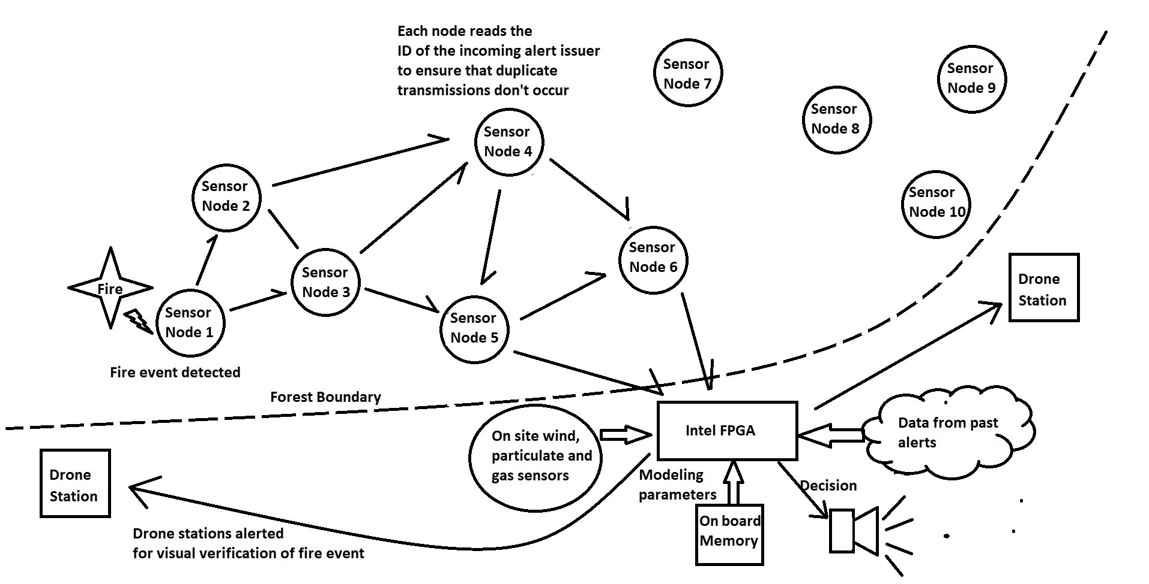
Functional Description

Slide 7
Functional Description
Sensor nodes
FPGA Base station
Sensor nodes equipped with Long-Range (LoRa) communication are scattered throughout the forest along the areas of human activity.
Each node has a temperature sensor and can talk to two neighboring nodes.
Network of nodes covers the entire forest. The nodes at the periphery of the forest are in contact with the FPGA.
Nearest neighbor communication ensures that fire alerts are relayed to the FPGA which sits near the forest rangers’ office.
Minimizes false alerts and keeps a log of past fire alerts.
Logs incoming fire alert and lets the rangers know where the fire alert is originating using the unique Node-ID of the alerting node.
The rangers can verify if the alert was true or if a node was falsely triggered.
FPGA keeps a log of alerts data. When enough data is available, it can run a Multiple-Linear-Regression model to determine if an incoming fire alert is true.

Slide 8
Sustainability study

Slide 9
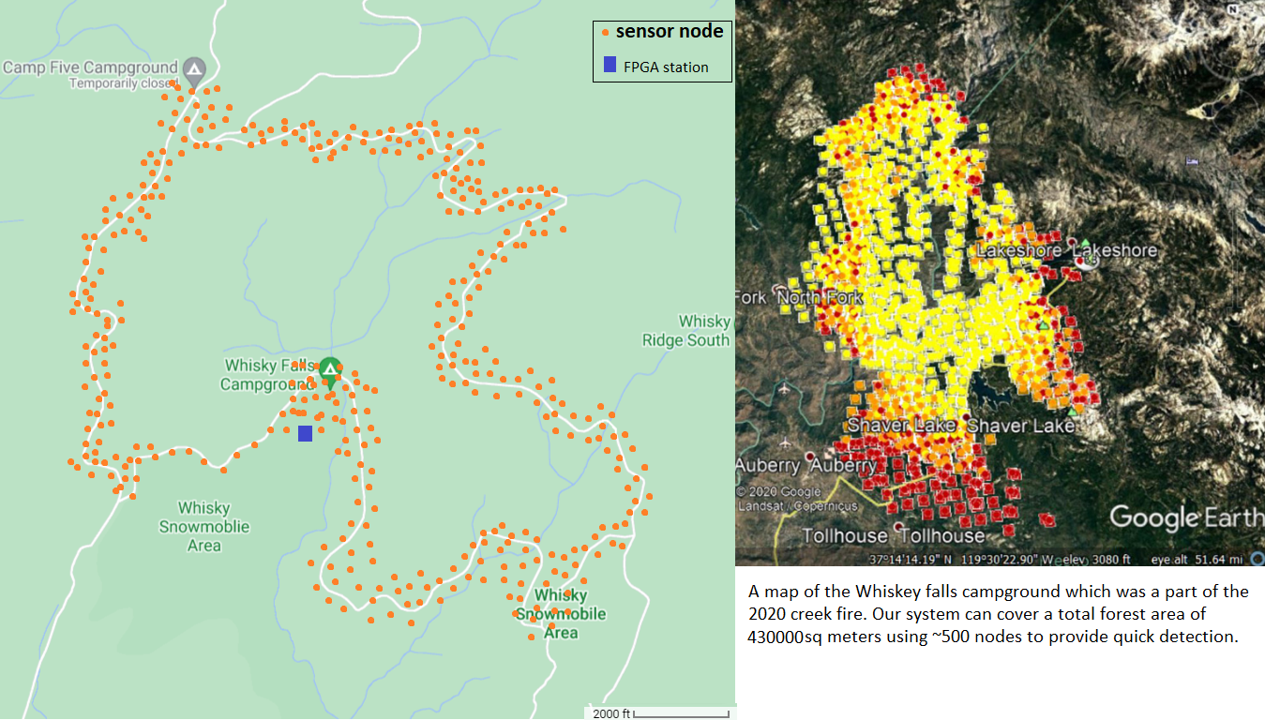
Sustainability study – The case of creek fire (2020)
The creek fire of 2020 burnt down 379,895 acres of forest and cost ~193mn USD.
Containment efforts began a week after the fire started, driven by satellite images.
Consider the deployment of our system at the Whiskey Falls campground, close to where the fire actually began.
Cover areas that are frequented by humans- hiking trails, biking trails and camp grounds.

Slide 10

Sustainability study – The case of creek fire (2020)
Each group of 3 sensor nodes covers an area of 2580sq m of forest.
A network of ~500 nodes sufficient to cover the whiskey falls trails and camp ground.
Total area covered = 430000 sq.m
Total cost of deployment = $13K

Slide 11
Exploratory Data Analysis

Slide 12
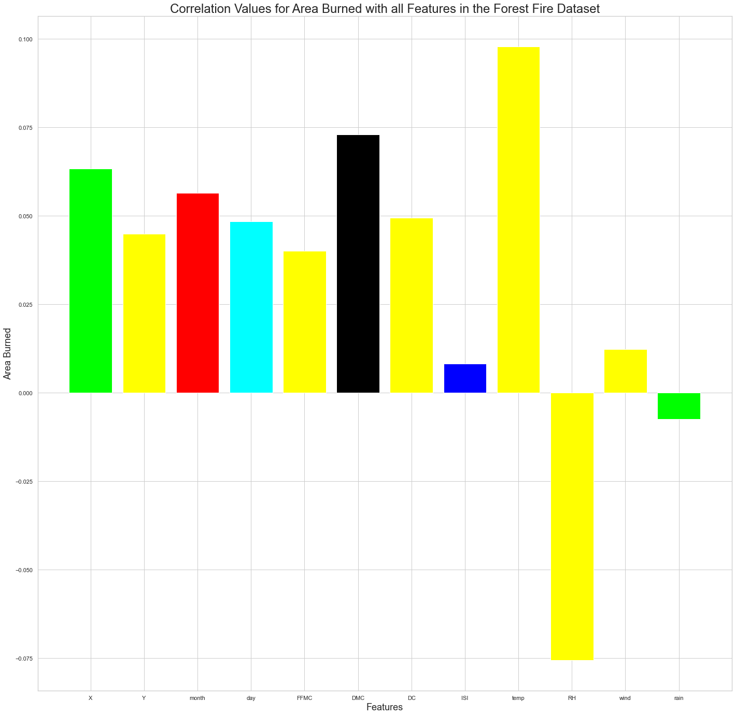
Exploratory Data Analysis
Dataset By-
P. Cortez and A. Morais. A Data Mining Approach to Predict Forest Fires using Meteorological Data

Slide 13
Conclusions
EFFICIENT
Quick detection of forest fires
FPGA makes the system adaptable and reprogrammable
Reliable system with negligible false alarms
ECONOMICAL
Zero maintenance cost
Minimal implementation cost
Estimated implementation cost of 13,650 USD to save ~193 million USD.
E
W
E
Reliable in the long run
Suggested tree topology can be scaled up very easily
Built-in robustness and reliability that increases over time
SCALABLE
Environmentally non-intrusive system
Millions of hectares of forests can be saved by prompt response
Proposed fire alert system becomes more technologically sustainable with time due to more data.
SUSTAINABLE
O
S
S
T

Slide 14

Thank you
Rahul Khamkar
Srimonti Dutta
rkhamkar1977@gmail.com
srimonti@iitg.ac.in

